Slide 1
College Registration System
Kevin Harville

Slide 2
Step 1: Clarify Current Situation
Is the issue
that the system is “legacy,” or
that the legacy system is slow, or failing, or
that it is anticipated to fail?
What failings and defects?
Known defects: Flat file not optimal / scalable
Lagging at peak times?
Who will maintain the system?
What specific data is in the legacy flat file ?
Clarifications: How labs relate to classes (optional, mandatory, 1:1 or 1:many)
Stakeholders / Communication / Responsibility & Authority
How do students log in? Are they already logged in via another existing system?
Risks (don’t kill the old system!)

Slide 3
Assumptions to Verify
The professor/staff “class entry” system is, at this time, to be unchanged
The goal is to eventually move entirely from the legacy system
The developer and client are both comfortable with ASP.net / SQL Server
The client can maintain, or hire the developer to maintain, the system
The students have login permissions. We need to copy them, or at least the user names and emails, or log in via a centralized means.

Slide 4
Step 2: Determine Overall Timeliness
How urgent?
Stopgap measures needed?
6 months to program (including meetings, approvals)
1 year to safely implement and test as full replacement
Overlap time in which new system fully implements / demonstrates legacy capabilities, with eventual replacement

Slide 5
Application / Solution: Requirements
Allow students to:
register for their classes,
view their schedule,
see their place on waiting lists if class is full when they register, and
view the classes their professors are teaching.
Remove self from class
Log in / Log out
Maintain legacy system integrity (don’t change)
Scalable to 25,000 + students (much larger is OK using SQL Server)

Slide 6
PROPOSAL--OVERALL
ASP.net application
Mirror legacy system capabilities
with a Relational DB (SQL Server)
Read class offerings from legacy DB
mirror to new system
Mobile and Web capabilities
We deal only with the flat file in inter-system communications
PHASE 2: Propose future update for staff Class Entry System

Slide 7
Technical Needs
SQL Server 2010+
Less than 1G needed based on current estimates
Windows Server 2012+
IIS
RAID / Secondary Storage Location / Cloud Storage
Regular Backups

Slide 8
PROPOSAL
LEGACY SYSTEMS
NEW SYSTEMS
CLASS INPUT
REGISTRATION
REGISTRATION
APP / WEB
FLAT FILE
Automatic or Manual Option
SQL SERVER
XFER / REMAP DATA
Eventual XFER to State
XFER to State

Slide 9
Pages
Integrated Login
Search Class / List Majors
Dynamic (like Google search)
Click to add class
Show Class List by Major
Click to add class
View Student Schedule
Click to Remove
View Class Details
Click to add
View Professor Schedule
Admin overrides

Slide 10
DATABASE TABLES
Students
Classes / Labs
Prerequisite XREF
Professors
Student Class xref
Professor Class xref
Class / Lab xref
Majors
Major / Class xref?

Slide 11
StudentClassXREF Table
XREFID
StudentID
ClassID
Enrolled T/F for wait list
CreatedDate
NOTE: Detail pages include only the tables of particular note.

Slide 12
Classes Table
ID
Code
ClassName
ProfessorID
Students
LabClassXREF
ClassType
All tables will also have tracking info, as needed and agreed. Examples:
EntryBy
CreatedDate
LastUpdatedBy
LastUpdateDate
ActiveStatus
ApprovedBy (i.e. prof. approval)
ApprovalDate
Override (i.e. prerequisite override)
Overridden By

Slide 13
PrerequisitesXREF Table
XREFID
ClassID
PrerequisiteID
Type (option of several, mandatory)
CreatedDate
CreatedBy
ActiveStatus

Slide 14
Classes and Methods
Classes
Class
Professor
Student
Methods based on Actions
SearchClasses
ListMajors
ListClassesByMajor
AddStudentToClass
AddStudentToWaitlist
RemoveStudentFromWaitlist
UpdateWaitList
ShowWaitList
RemoveStudentFromClass
ViewProfessorsClasses
ListClassDetails
VerifyLogin
Further Methods
VerifyPrerequisite
UpdateLegacyDB
UpdateClassFromLegacyDB

Slide 15
Registration
Class Search
Majors:
Anthropology
Archaeology
Beekeeping
Boating
…

Slide 16
Registration
Class Search
Majors:
Computer Engineering
Computer Science
Classes:
CODE CLASS TIME PROFESSOR
CE 101 Robotic Advances MW 2pm-4pm Asimov ADD CSC 101 Computer Ethics – Skynet and AI Risks TTH 10-12 Connor WAIT
CSC 202 Computer Science 202 – Web Development MWF 8-10am Harville ADD
LAB MW 12pm-2pm TBA
Comp
The waiting list has 5 students.
ADD TO LIST

Slide 17
Registration
My Schedule
CODE CLASS TIME PROFESSOR
CE 101 Robotic Advances MW 2pm-4pm Asimov DROP CSC 101 Computer Ethics – Skynet and AI Risks TTH 10-12 Connor DROP
Wait List
Enrollment in these classes is contingent on future openings:
CODE CLASS TIME PROF. POSITION
CSC 202 Computer Science 202 – Web Development MWF 8-10am Harville 4 DROP
Please drop any unwanted classes from wait list to free the class for other students.
Back
You are currently
4th in line for
This opening

Slide 18
Registration
CE 101: Robotic Advances
CODE CLASS TIME PROFESSOR ROOM SPOTS STU
CE 101 Robotic Advances MW 2pm-4pm Asimov SC101 4 30 ADD
CE 101 Robotic Advances TTH 12pm-2pm Data X123 -3 25 WAIT
PREREQUISITE: CE 100 History of Robotics This class covers the 3 laws of Robotics, how robots can serve us, and when they are likely to take over.
Is the Singularity near, or will humanity progress as master, servant, peer, or cyborg? What does it mean
to be human?
LAB – OPTIONAL
CODE CLASS TIME PROFESSOR ROOM SPOTS STU
CE 101L BattleBots S 10am-2pm Deckard RM222 4 50 ADD
Back

Slide 19
Registration
SCHEDULE: Professor Asimov
CODE CLASS TIME PROFESSOR ROOM SPOTS STU
CE 101 Robotic Advances MW 2pm-4pm Asimov SC101 4 30 ADD
CE 102 Designing the Future TTH 12pm-2pm Asimov X124 -1 30 WAIT
CE 122 Technical Writing TTH 2pm-4pm Asimov X124 4 30 ADD
Back

Slide 20
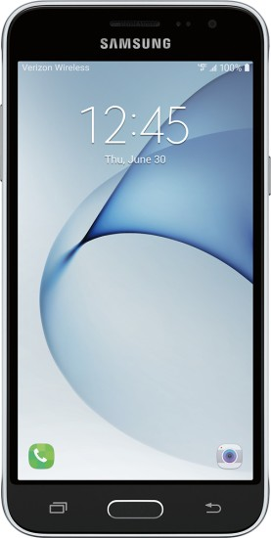
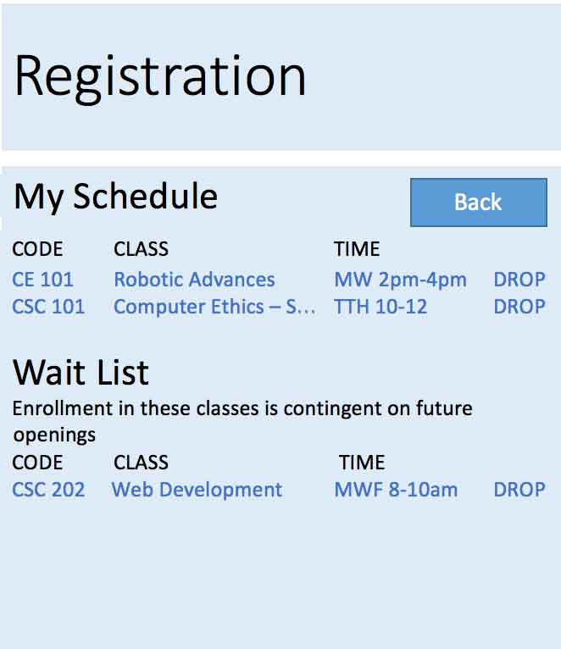
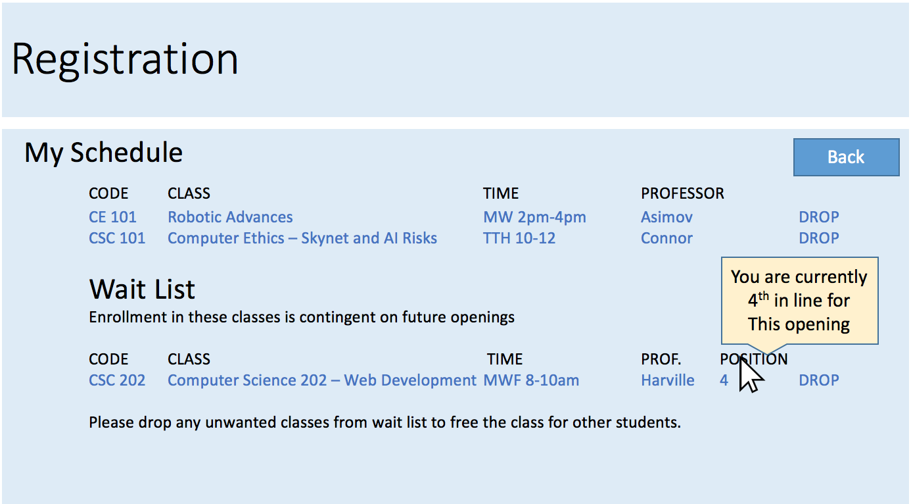
SAMPLE MOBILE APP
HTML or HTML / Code Hybrid
Provides same functionality
May have simpler functionality at face, but allows same functionality by digging deeper (due to screen limitations)

Slide 21
Exclusions
The following are not included under this current proposal:
Class entry system for staff (PHASE 2 Proposal)
Analysis of class suitability (does it fit one’s goals / major)
Features such as graphical schedules are available as extensions to this proposal

Slide 22
SCHEDULE OVERVIEW
September 2016: Approval
October 2016: Get Stakeholder Buy-in / Perform Technical Review (i.e. flat file review. Permissions. Verify interfacing ability)
November 2016: Finalize Requirements Documents. Duplicate legacy system for development. Order / Obtain Hardware.
December 2016: Requirements Review. Final changes agreed upon.
January – March 2017: Programming / Development.
April – May 2017: Demo. User Testing. A/B Testing. Beta Testing. Debugging.
June 2017: Final Tests. Switch to Live
July 2017: Live Testing
August 2017: Implementation. Contingency: With any obstacles implementation moves to Fall’s registration for Spring.

Slide 23
Outcome
SQL Server and a web based system is easily scalable to serve 25,000 students and future growth
The system will be able to interface directly with the state for switchover
The system will and eventually replace the legacy system
Students could register via their PC, school web-connected computers, or mobile
The class entry system could be updated as well in the future
Result: A modern, stable scalable, web-based, mobile-friendly system.

